Slide 1

Module 7.2 Pager Rotation Best Practices
Presented by Jon Green

Slide 2

Topics
Assemble the team
Establish the rotation
Defining Responsibilities
Event Handling Duties
Closing Tasks

Slide 3

Assemble the team
The rotation team works best when it consists of members who are already familiar with the tasks at hand and remediation techniques. Determining which members will be part of the rotation will be based on several criteria including experience and ability to deploy resolutions. The organization should select engineers and members who have completed sufficient training to resolve issues in a timely manner. Assign primary and secondary responders.

Slide 4

Establishing the Rotation
A good practice is to define the rotation. Be sure to establish clear hours and timeframes that the rotation will take place. Create a clearly defined schedule in which each member will be responsible for completing the rotation. Utilize schedule management software to maintain the active schedule. This will make things easy to quickly view the schedule status as well as seeing which member will be on rotation.

Slide 5
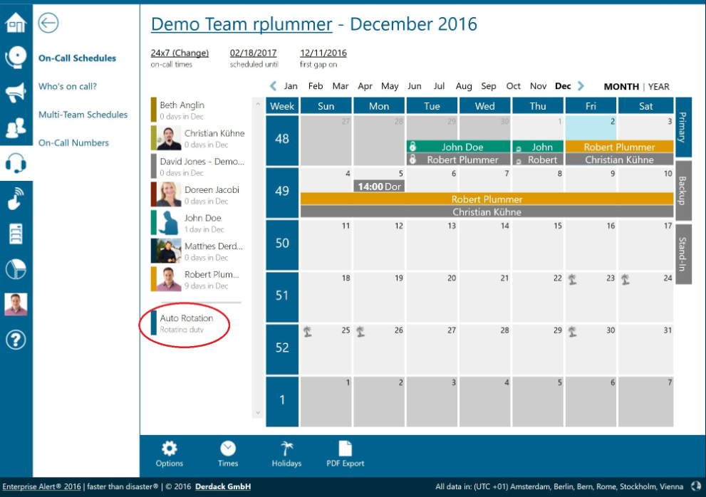
Example of Rotation Schedule
“On-Call Schedule Management with Auto-Rotation.” Derdack, 5 Jan. 2017, www.derdack.com/on-call-schedule-auto-rotation/. Accessed 21 Sept. 2024.

Slide 6
Defining Responsibilities
It is important to clearly explain what is required for this role. Be sure to separate the on-call duties from the standard engineering duties. The method of contact will be established (chat, text, call, or email). We will define the responsibilities while on the rotation and explain how it impacts your current role while not on the rotation. Clear guidelines for expectations will be defined during the call rotation hours. A role hierarchy system will also be put in place so that certain users will be granted additional permissions and access.

Slide 7
Event handling Duties
Review logs regarding prior and potential events
Prioritize events based on severity
Classify events based on impact
Actively monitor the situation
Determine if you are equipped to deploy resolution
Establish an escalation path
Determine path for resolution
Engage appropriate teams
Confirm Resolution
Create a log and document the events

Slide 8

Closing Tasks
Communicate with cross functional teams to ensure that the issue is resolved.
Monitor reports and provide feedback.
Provide summary of events for the next rotation
Document and log the resolution to be stored in the incident file.

Slide 9

Sources
Squadcast. “Mastering On-Call Rotations: A Comprehensive Guide and Best Practices.” Medium, Medium, 29 May 2024, medium.com/@squadcast/mastering-on-call-rotations-a-comprehensive-guide-and-best-practices-5537659b712f. Accessed 21 Sept. 2024.
‌“On-Call Rotations.” OnPage, www.onpage.com/guide-to-facilitating-equitable-on-call-rotations/.
‌
https://itrevolution.com/articles/the-three-ways-principles-underpinning-devops/
https://amazic.com/how-the-role-of-on-call-devops-is-changing/
https://fellow.app/blog/engineering/on-call-engineering-best-practices-pros-cons/
“On-Call Schedule Management with Auto-Rotation.” Derdack, 5 Jan. 2017, www.derdack.com/on-call-schedule-auto-rotation/. Accessed 21 Sept. 2024.
‌
“Who Is Typically the On-Call Person in a DevOps Team?” Quora, 2019, www.quora.com/Who-is-typically-the-on-call-person-in-a-DevOps-team. Accessed 21 Sept. 2024.
‌

